Slide 1
College Network with DNS, FTP and Web Servers Presentation

Slide 2
Group Members
Abdullah Javed 20-CE-035
Abdullah Bhatti 20-CE-011
Fatima Asim 20-CE-029
Ayesha Ehtisham 20-CE-038

Slide 3

Project analysis slide 2
CONTENTS
INTRODUCTION
ROUTING PROTOCOL
EXISTING NETWORK
NETWORK DESIGN
REQUIREMENTS
NETWORK TEST
NETWORK DEVICES

Slide 4
Project analysis slide 3
INTRODUCTION
Network Topology: LAN
Communication Between Different Departments
Provides Connectivity Through Out The Campus
Provides Services Like FTP, DNS, and Web

Slide 5
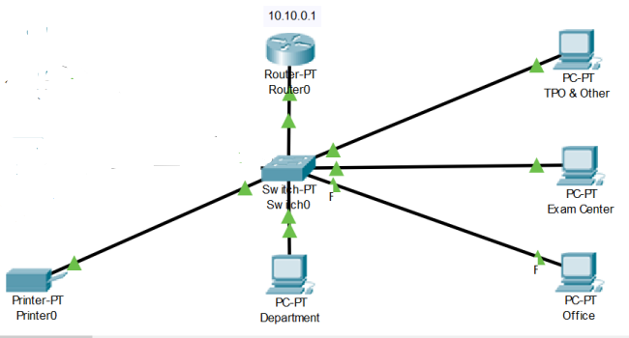
Project analysis slide 3
EXISTING NETWORK

Slide 6

Project analysis slide 4
REQUIREMENTS
REQUIREMENTS
REQUIREMENTS
SUPPORT
REMOTE ACCESS
SECURITY
FEATURES
FAST SPEED
SCALABLE
.
Resources

Slide 7
Project analysis slide 6
NETWORK DEVICES
.
2960
Switches
Router-PT
FTP Server
Web Server
DNS Server

Slide 8
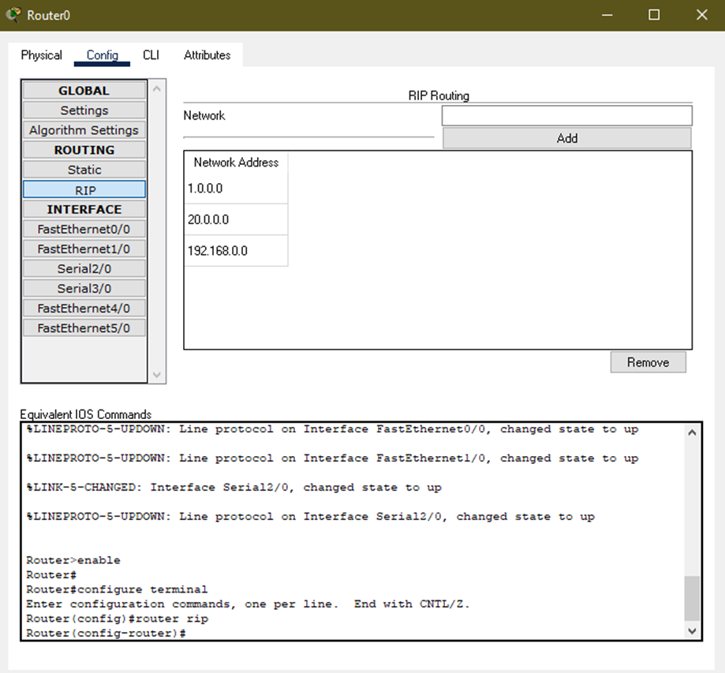
Project analysis slide 7
Routing Protocol for Router 0

Slide 9
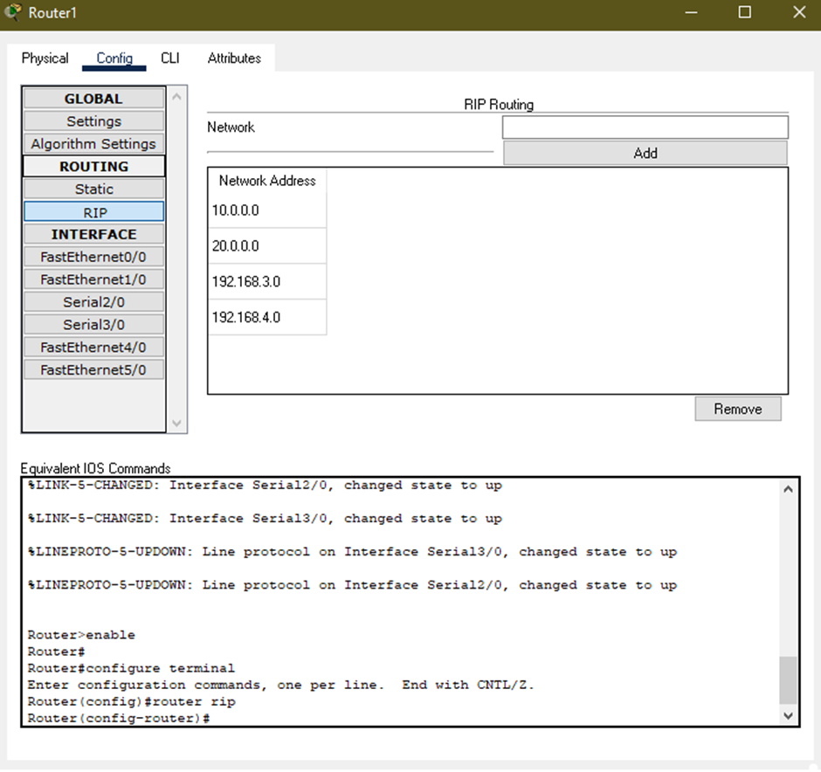
Project analysis slide 8
Routing Protocol for Router 1

Slide 10
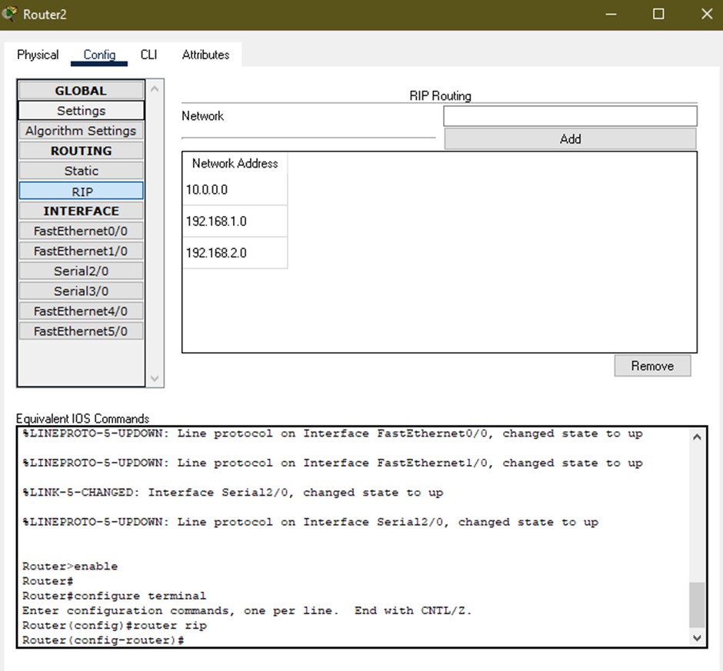
Project analysis slide 10
Routing Protocol for Router 2

Slide 11
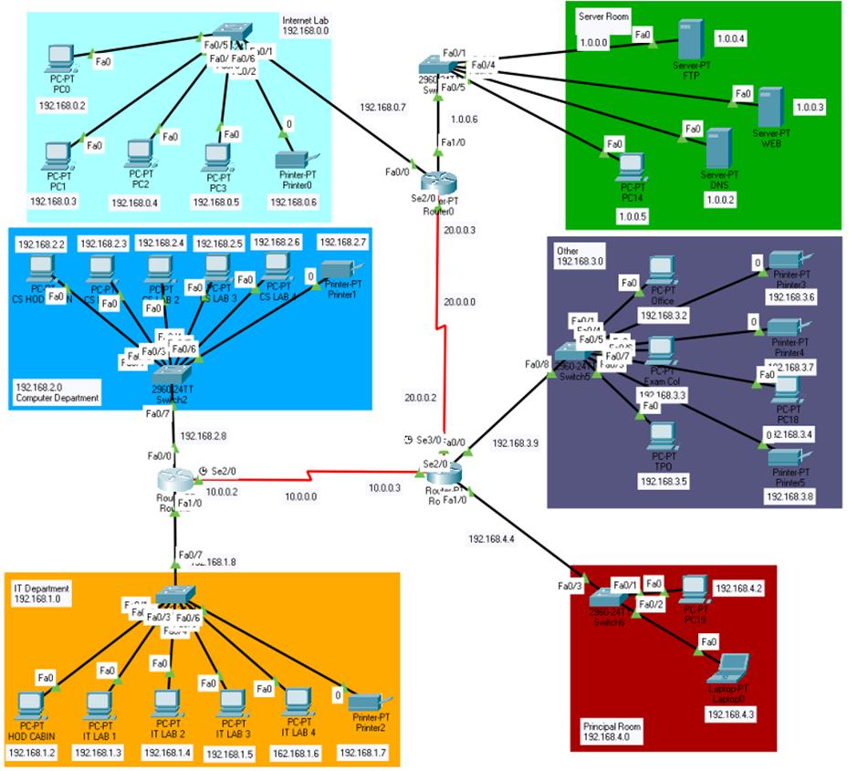
Project analysis slide 11
Network Design Diagram

Slide 12
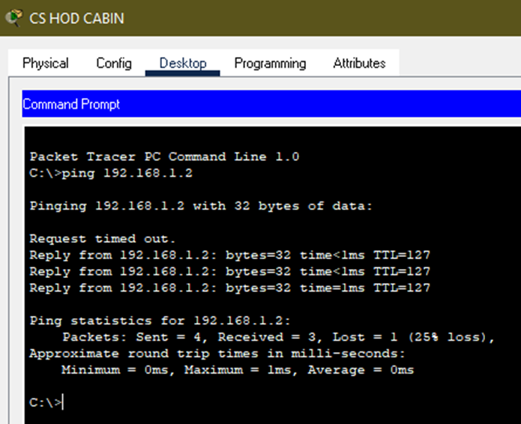
Project analysis slide 5
Network Test

Slide 13
Thank You

